Slide 1
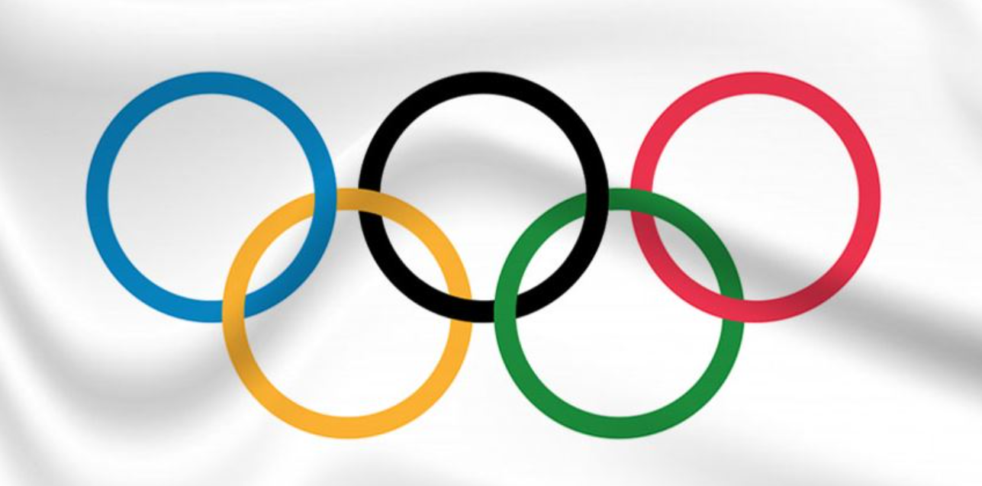
Team 1 - Project 1
Summer Olympics (1976-2008)
Presented by Sayeda
Hanife
Deji

Slide 2
Agenda
Introduction
Data Imports, Cleanups & Modules
Question 1 – Top Performing Country
Question 2 – Analysis of Female Participation in the Olympics
Question 3 – Greatest Rivalry : USA vs Russia
Conclusion

Slide 3
Introduction
What is it ?
The Summer Olympic Games are the premier sporting event where thousands of athletes from around the world compete in various disciplines. With over 200 nations participating, the competition to be crowned the best in any event is intense.
Olympics Trivia
Which country founded the Olympics?
What do the five rings represent ?
Thesis
Our project focuses on analyzing performance, identifying trends, and drawing conclusions that extend beyond the realm of sports.

Slide 4
Importing Modules, Data & Cleanup
Modules used
Pandas
Seaborn
Numpy
Matplotlib
Data
Kaggle - 1976 - 2008 Summer Olympics (Country, Athlete, Event, Medal, Year etc.)
https://www.kaggle.com/code/vardhansiramdasu/summer-olympics-eda
Cleanup
Dropna
Verify ‘Year’ = Integer
Everything else = Object

Slide 5
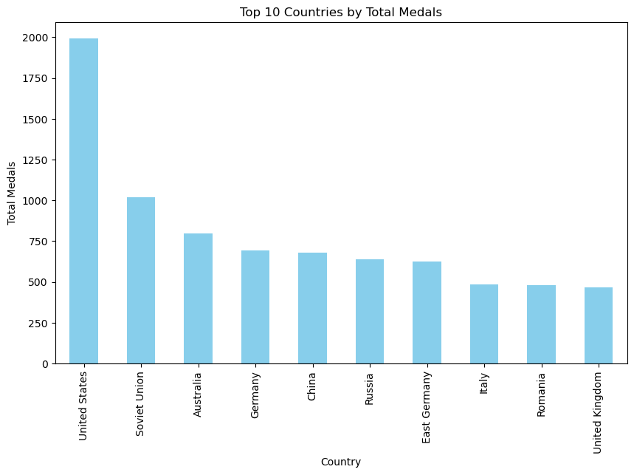
Question 1 – Top Performing Country by Medals
Exercise
Groupby function
Count ‘Medal’
Bar Plot
Finding
USA is the top
Performer by a large margin

Slide 6
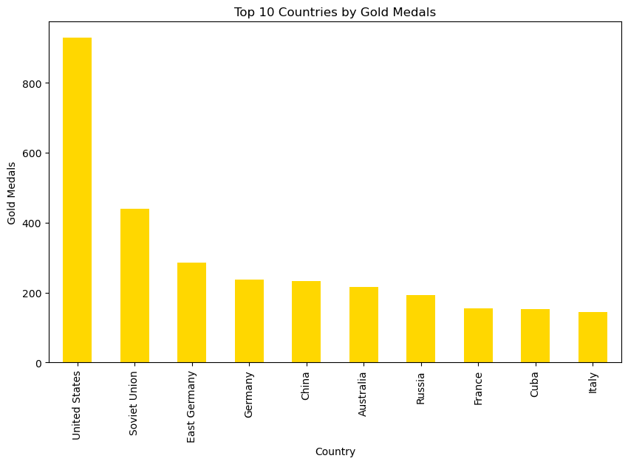
Question 1 – Top Performing Country by ‘Gold’ Medals
Exercise
Groupby function
Count medal = ‘Gold’
Bar Plot
Finding
USA is the top
Performer by a large margin

Slide 7
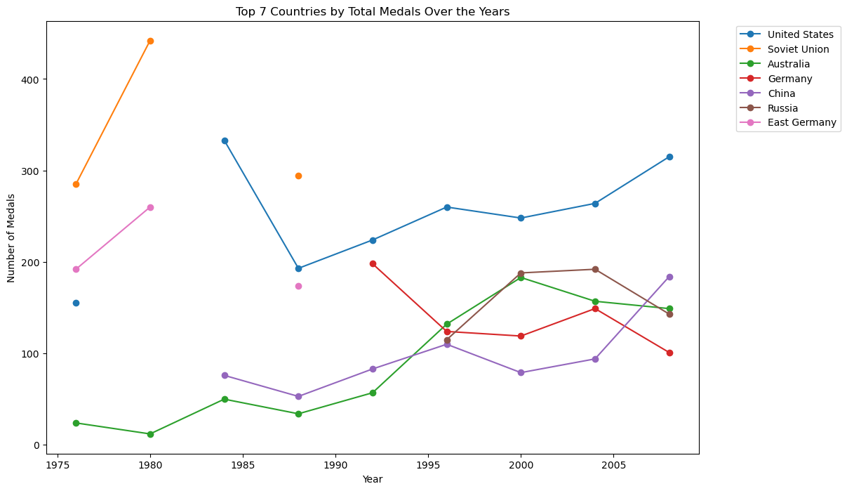
Question 1 – Time Series of Medals Won
Exercise
Pivot table function
‘Year’, ‘Country’,
and medal count
Finding
USA is the top
performer
Decline of Soviet
Emergence of China

Slide 8
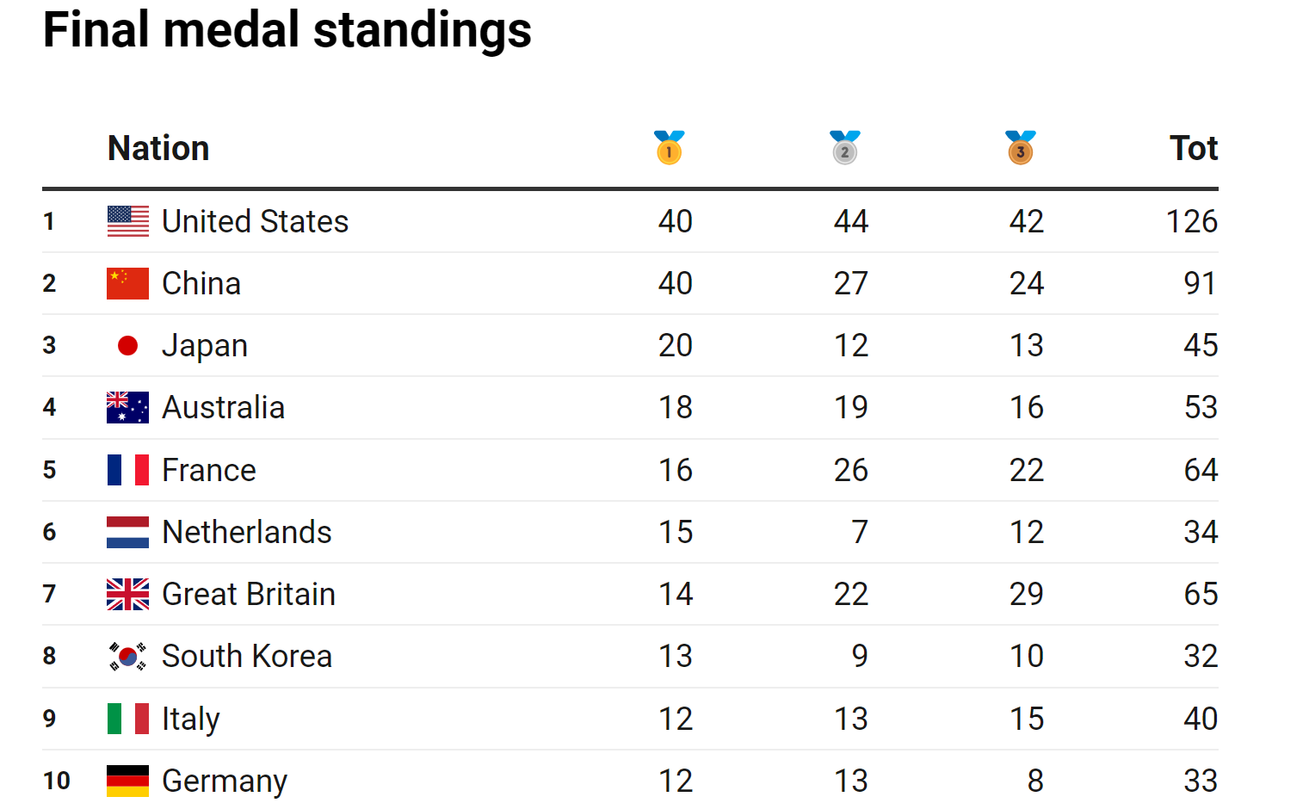

Slide 9
Analysis of Female Participation in the Summer Olympics (1976-2008)
Trends, Insights, and Implications

Slide 10


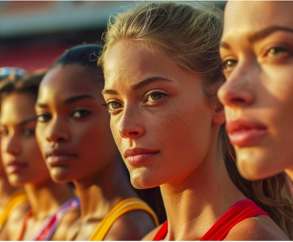
Significance of Analysis:
Analyzing women's participation in the Olympics sheds light on broader trends in gender equality within the international sports arena.
Scope of Data:
The data spans over three decades, from 1976 to 2008, covering multiple Summer Olympic Games.
It includes participation details across various sports and disciplines, along with medals won, and the countries represented.
Objective:
By studying these trends, we aim to understand the impact of socio-political changes, policy shifts, and global movements on the opportunities available to female athletes.

Slide 11
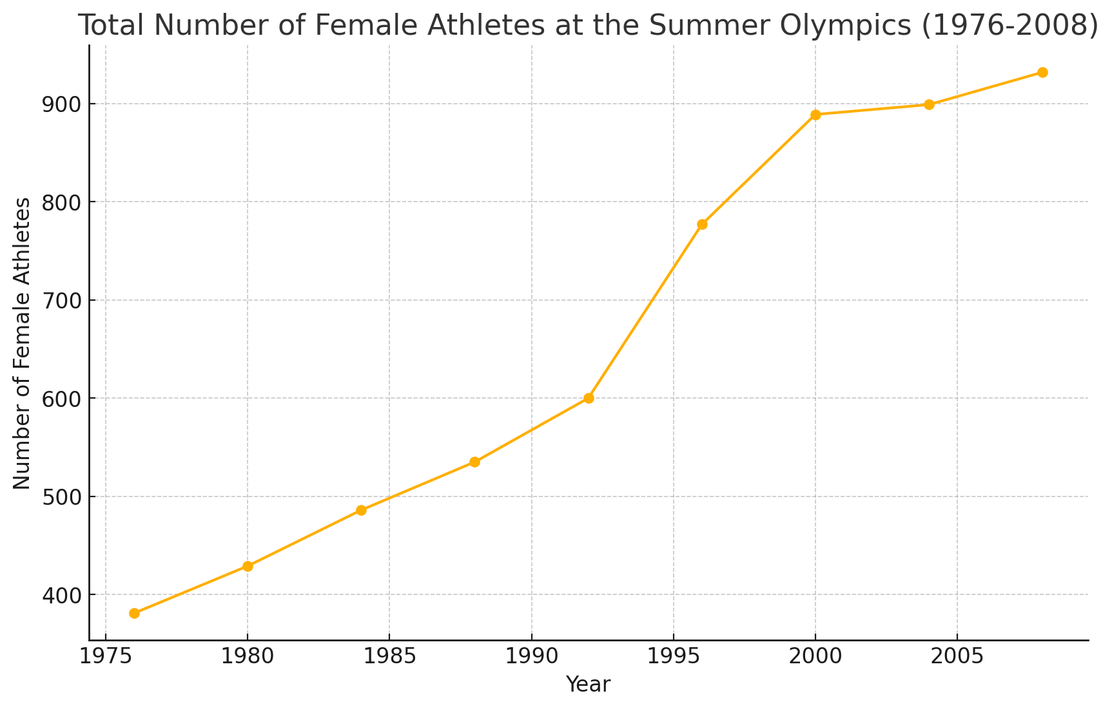
Total Number of Female Athletes at the Summer Olympics (1976-2008)
Overall Growth: There has been a consistent increase in the number of female athletes participating in the Summer Olympics from 1976 to 2008, reflecting the growing gender inclusivity in the games.
Significant Milestones:
The 1996 Olympics saw a significant increase in female participation, jumping nearly 30% from 1992.
The trend continued upward, with almost every subsequent Olympics seeing an increase in female athletes, highlighting ongoing efforts towards gender parity in sports.

Slide 12
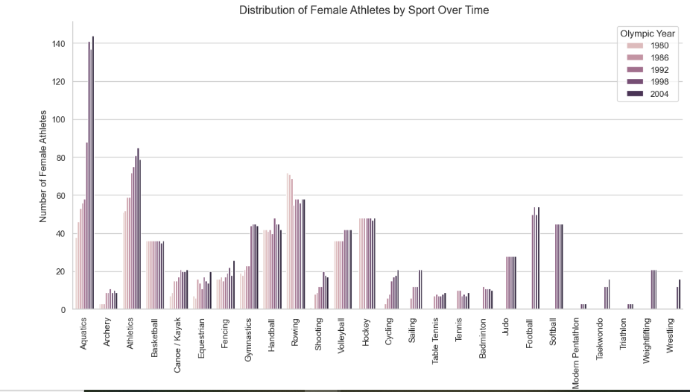
Maximum number of female participants is seen in AQUATICS event.

Slide 13
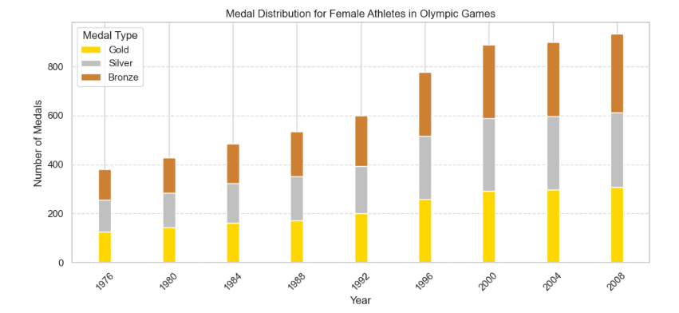
Medal Distribution Among Female Athletes:

Slide 14

Over the span of the eight Olympic Games from 1976 to 2008, there has been a noticeable and consistent increase in the number of medals awarded across all categories: Bronze, Silver, and Gold. This trend reflects the overall growth in the scale and participation of the Olympic Games during this period.
The data shows a substantial rise in medal counts between 1992 and 1996, with Bronze, Silver, and Gold medal counts increasing by approximately 25-30%. This surge may be attributed to several factors, including the dissolution of the Soviet Union, the emergence of new countries participating in the Olympics, and an overall expansion in the number of events and athletes.
Between 2000 and 2004, the growth in medal counts appears to stabilize slightly, with smaller increments in the number of medals compared to the previous decades. This stability might indicate a plateau in the number of events or a balanced distribution of medals among participating nations.

Slide 15

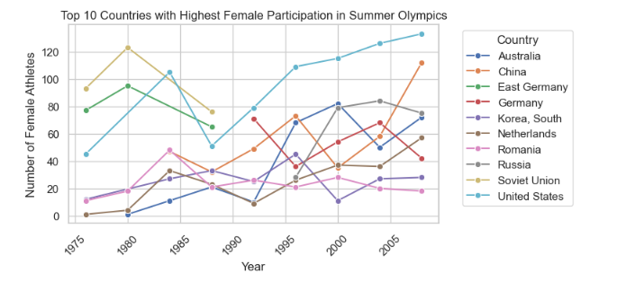

Slide 16

East Germany, show a peak followed by a sharp decline
Other countries like China and the United States show a more consistent upward trend
The trajectories for countries like the Soviet Union and Russia indicate the impact of geopolitical changes.
Countries like China and South Korea display rapid growth in female athlete participation
Countries such as the Netherlands and Germany exhibit relatively stable growth patterns.
He recently opened a camera shop near the Louvre in Paris.
Visitors to his store, mostly tourists, speak many different languages making anything beyond a simple transaction a challenge.

Slide 17
Correlate historical events and policy changes with the data trends and discuss their possible impacts.
Identify Major Policy Changes
Title IX (1972, USA): Mandated equal opportunities for women in sports and education,
International Olympic Committee (IOC) Policies
Global Initiatives

Slide 18

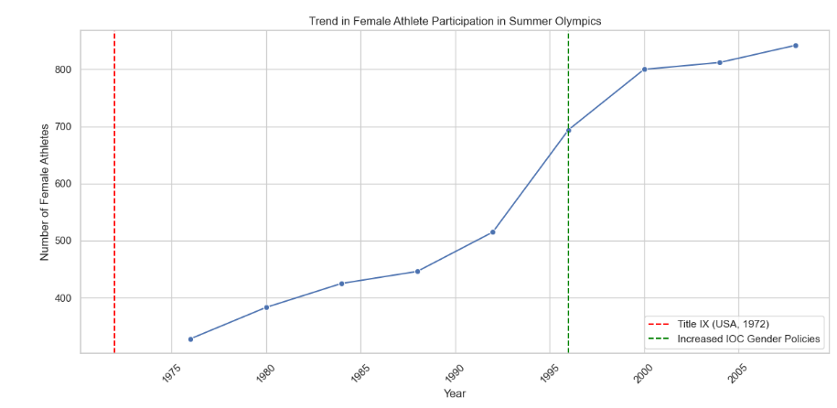
A translation barrier left Alberto feeling lonely and hurt Marco’s business.

Slide 19

Then, Marcos discovered Google Translate
He has his visiting customers speak their camera issues into the app.
He’s able to give them a friendly, personalized experience by understanding exactly what they need.
In 2024 Summer Olympics, this trend continues, with women competing in a broader range of sports and events than ever before!

Slide 20

Section 3 - Greatest Rivalry:
Russia vs USA

Slide 21

Why This Comparison?
The USA and Russia are Olympic powerhouses with a historic rivalry that goes beyond sports. Comparing their performances reveals how these nations used the Olympics to showcase strength during the Cold War and beyond.
Why We chose five key metrics?
Total Medals
Yearly Trends
Gender Balance
Top Sports
Medal Types
to give a well-rounded view of each nation’s strengths and strategies in the Olympic arena.

Slide 22
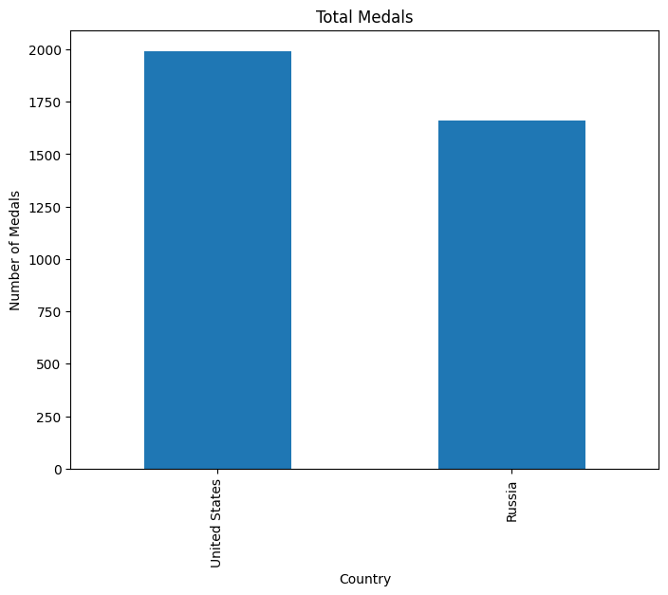
USA Dominance: The USA consistently leads in total medals, showcasing its broad athletic prowess across various sports.
Russia’s Strength: Russia (and the Soviet Union) also demonstrates strong performance, particularly in the earlier years, reflecting their strategic focus on the Olympics during the Cold War.

Slide 23
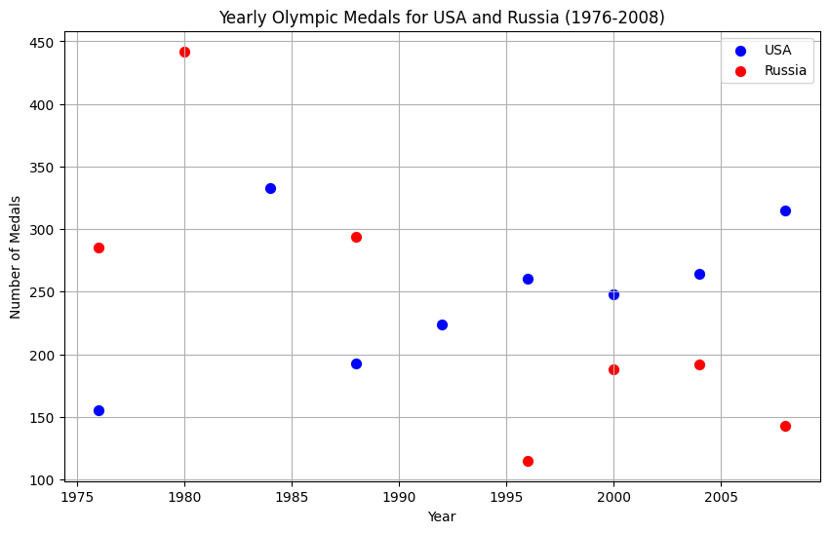
USA Performance: The blue dots show a fairly consistent number of medals won by the USA across the years, with noticeable peaks around the 2000s.
Russia's Variability: The red dots indicate more fluctuation in Russia's performance, with particularly high medal counts in the late 1970s and dips in the post-Soviet era.
Highlight:The 1980 and 1984 Olympics are highlighted by the distinct absence or reduction of medals due to the respective boycotts by the USA and the Soviet Union.

Slide 24
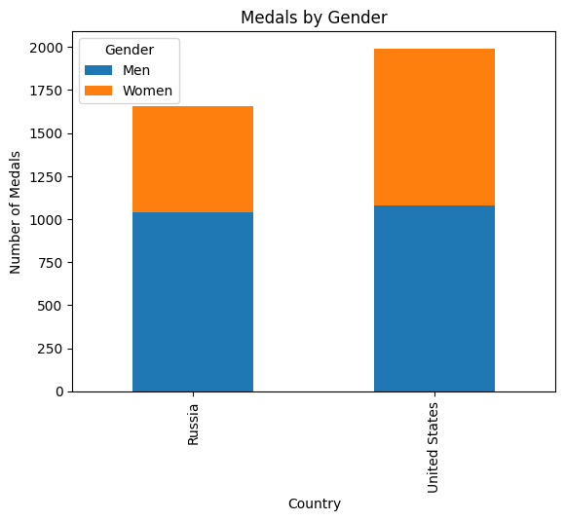
Balanced Success in the USA: The USA shows a nearly equal contribution from both male and female athletes, reflecting strong gender equity in their Olympic success.
Russia’s Male Dominance: Russia has a slightly higher contribution from male athletes, though female athletes also made significant contributions, especially in certain sports like gymnastics.
This chart highlights how both countries leveraged the talents of male and female athletes, with the USA displaying a more balanced gender distribution in its medal count.

Slide 25
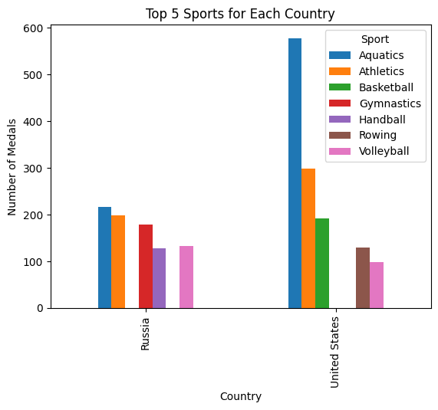
USA’s Strengths: The USA dominates in Aquatics, with over 500 medals, followed by strong performances in Athletics and Basketball.
Russia’s Strengths: Russia shows a more balanced distribution across multiple sports, with Gymnastics being their standout, followed by Aquatics and Athletics.
Comparative Advantage: The chart reflects each country’s strategic focus, with the USA excelling in water and track events, while Russia (including the Soviet Union) showcases strength in Gymnastics and team sports like Handball.

Slide 26
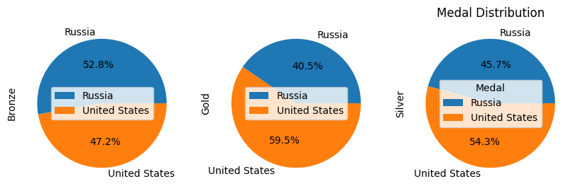
Gold Medals: The USA has a clear advantage in Gold medals, winning 59.5% compared to Russia's 40.5%. This highlights the USA's ability to secure top podium positions more frequently.
Silver Medals: The distribution of Silver medals is closer, with the USA still leading at 54.3% versus Russia’s 45.7%.
Bronze Medals: Russia slightly leads in Bronze medals, with 52.8% compared to the USA's 47.2%, suggesting that Russia often reached the finals but didn’t always win Gold or Silver.
These charts illustrate the USA's dominance in achieving top honors (Gold medals) while showing Russia's strength in consistently placing in the top three across multiple events.

Slide 27
The United States has consistently led Olympic performance by nearly every measure, including the highest total medal count since the inception of the Games. A significant factor in this success has been the high proportion of women participating in sports and winning medals. Generally, developed nations with higher GDP tend to be more progressive and invest heavily in sports programs, which in turn bolsters their athletes' performance on the global stage.
Conclusion

